Slide 1
OpenC2 & Network Telemetry:
Feeding needed data to OpenC2 Applications
Eric Voit
Principal Engineer
evoit@cisco.com
19-May-2017

Slide 2

Agenda
Telemetry OpenC2 Relationship
Asynchronous Network Subscriptions
OpenC2 relevant Use Cases

Slide 3

Telemetry OpenC2 Relationship

Slide 4
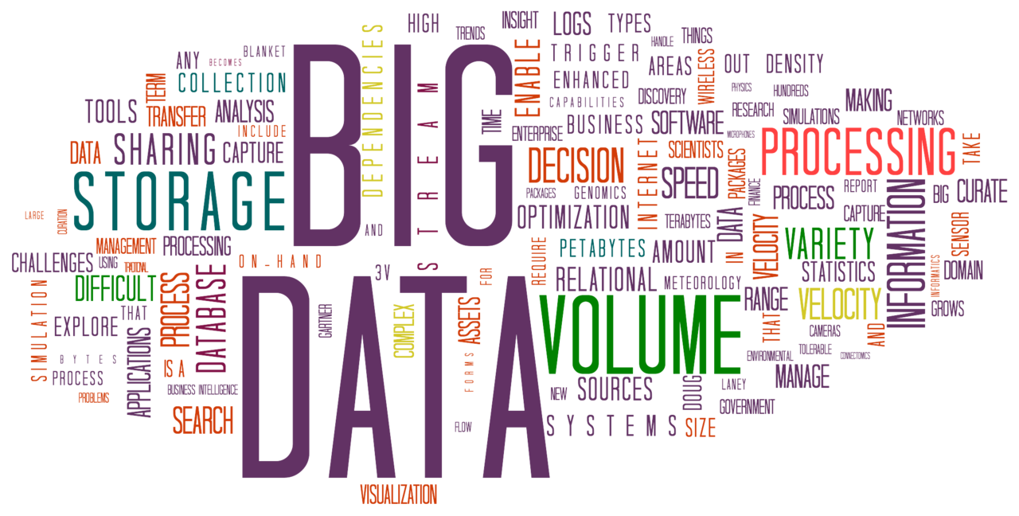
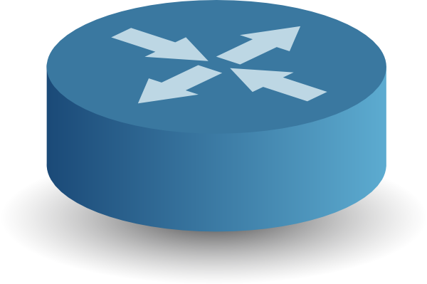
Streaming Telemetry
Subscriptions
Let’s push a whole lot of data to where it is useful
Notes:
https://commons.wikimedia.org/wiki/File:BigData_2267x1146_white.png#/media/File:BigData_2267x1146_trasparent.png

Slide 5

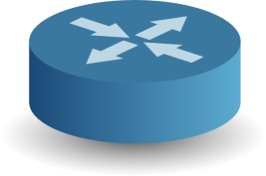
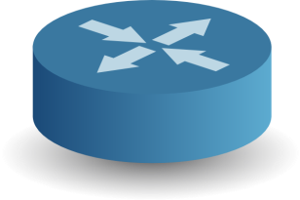
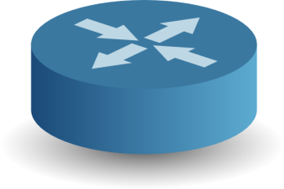
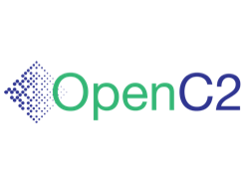
Network Policy Feedback Loop
Authoritative Network Data
Authoritative Decisions
Current Configuration &
Operational State
Flow fingerprints
Interface up/down
Instantaneous config
Instantaneous topology
Applications

Slide 6
Telemetry – Feeding Data to OpenC2 Applications
Authoritative Network Data
Authoritative Decisions
Current Configuration &
Operational State
Requirements
Standard
High volume
Prioritized push
Burst Dampening
Transport options
Multiple recipients
Structured & filterable
Synchronized intervals
Complete representation
Admission Control
Per-object security
Custom contents
Non-repudiation
Self describing
Subscribable
Low latency
Applications

Slide 7
Data Transfer Mechanisms
Authoritative Network Data
Authoritative Decisions
Current Configuration &
Operational State
 | CLI | SNMP | Traps | Syslog |  | YANG
Asynchronous
Scale
Standard
Structured
Complete
Security
Stable
Applications
Legacy (insufficient)
Emerging (objective is to get all to green)

Slide 8
Asynchronous Network Subscriptions

Slide 9
The “Push Zone”
Software
Version
1 month
Crypto
Keys
1 day
Asynchronous
Northbound
Pull Protocols
1 hour
Event
Traps
Event Frequency
Topology
Synchronous
ACL
Counters
1 minute
Syslog
1 second
Routing &
Switching
Protocols
Flow
Records
ASIC stats
Legend
0.1 second
Operational
Data
Ethernet
SONET
ARP
OSPF
Traps
BGP
SNMP
CLI
Configuration
Data
0.1 second
1 second
1 minute
1 hour
1 day
Required Notification Latency

Slide 10




Asynchronous Push has become a “MUST”
fetch
Continuous Polling
Continuous Polling
Datastore
Subscribing
Datastore
push
Subscribing
Anything different?
NO!
Just the new stuff
No.
Yeah.
Well known cost/scale limits with continuous polling
Propagation latency
CPU, Bandwidth
Multiple Polling devices
Up-to-date objects delivered
Reaction speed
CPU, Bandwidth reduced

Slide 11



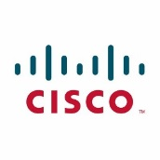

YANG Subscriptions Concept
Streaming of updates
Customized to recipient
Encoding (XML, JSON, …)
Transport (NETCONF, HTTP/2, …)
Subscribing to updates
Any YANG object / subtree on device
Datastore
Publisher
Subscription
interface
Streaming
mechanism
YANG

Slide 12
Two Types of Subscriptions
On Change
Push on Object change
Periodic
Push Object every ‘X’ seconds
Subscriber
Subscriber
asynchronous notification
uses ‘Patch’ syntax (add, change, delete)
regular cadence
sends a complete object set every time
Datastore
Datastore
Publisher of Object Deltas
Publisher of Objects

Slide 13
Result → Network Element Feedback Loop
OpenC2 Application
Subscriber
Controller
Controllers holding network state can publish operational and config info
Publisher
Application
Also viable as part of fast reacting multi-layered abstraction
Subscriber
Network
Element
CLI
YANG
Publisher

Slide 14
OpenC2 relevant Use Cases

Slide 15
Subscribable Objects
Security
Controller
Troubleshooting
Capacity Management
Network
Element
Counters
Oper Status
Routes
Config
Flows
Routes
Oper Status
Config
Oper Status
Config
Oper Status
Counters
Routes
Config
Network Element
Datastore
Counters
Oper Status
Routes
Config
Flows
Notes:
(Use PPT View for animations)

Slide 16
OpenC2 Use Case & Subscribable Objects
Use Case | Cares about | Subscribe to?
 |  | Config | Oper Status | Routes | Counters | Flows
Block on Indicators | Potential Indicators of compromise
Host Remediation | Current running processes & config
HBSS Signature | Environmental conditions
Mitigate Evil Domain | Control & Data Plane activity

Slide 17
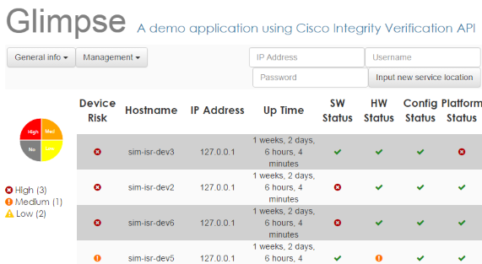

Host Remediation & Block on Indicators with On-change Push
Intrusion Detection Application
Cisco’s Intrusion Detection Application currently polls for changes ~2x a day
With on-change, the intrusion detection goes from hours to sub-second
OpenC2
Controller
running software version
IP addresses of neighbors
logged on users
ACL configuration
physical hardware
software checksums
keys in keychain
Subscription

Slide 18

Mitigate Evil Domain with Periodic or On-change Push
Data Center Enclave
Anomaly
Detection
Inbound traffic monitored for indicators
On anomaly, immediately bridge in assets such as DDoS scrubbers and IDS for origin subnet(s)
OpenC2
Attacker
VM
Botnet
IDS
DDoS
Scrubber
Subscription
Traffic counters
Inter-packet-gap histogram
QoS queue drops
Server response time
Late responses

Slide 19



Telemetry / Subscription: IETF & Google Code Available for Each Path
2014
2015
2016
2017
IETF 91
IETF 92
IETF 93
IETF 94
IETF 95
IETF 96
IETF 97
IETF 98
Pub/Sub Requirements
RFC 7923
Restconf & HTTP Transport
YANG Datastore Push
draft-ietf-netconf-event-restconf
draft-ietf-netconf-yang-push
NETCONF Transport
draft-ietf-netconf-event-netconf
Subscriptions for Event Notifications
draft-ietf-netconf-subscribed-notifications
Notifications2
draft-voit…
OC-Telemetry
GitHub: openconfig-telemetry.yang
gNMI
draft-openconfig-rtgwg…

Slide 20
Binding OpenC2 into the Network Configuration should be at the highest Aggregate Level Possible
Hierarchy of Configuration Domains
It is more efficient (and safer) for OpenC2 to configure only a data field at the highest exposed level
That place changes
Location independent
Example: Global ACL rules, QoS Class Definitions,
Bounds of Protocol
Example: VRF ACL, OSPF area
Router / Switch
Example: User ACL rules, Authentication Keys
Notes:
Such mechanisms can be fortified with configuration checks to validate consistency across and within the Hierarchy

Slide 21

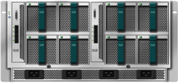

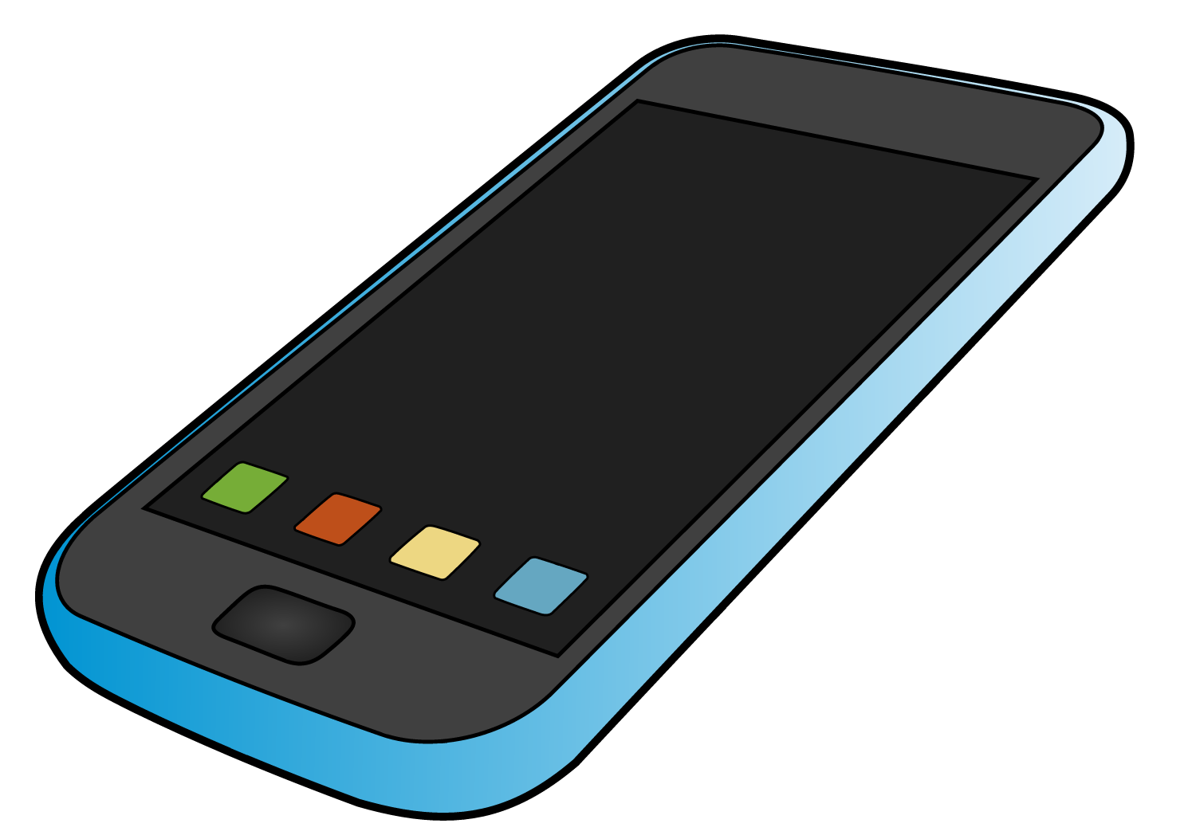
Binding OpenC2 into the Network Info carried within the abstraction will vary
Client
/
Network Services
Applications
Apps
Security
Subscriber Mgmt
Workflow Management
System Management
Compute & Storage
SDN Controller
Orchestration
Network Management
Scalable Cloud Platform
Openstack
Virtual DataCenter
Common Elementary Functions (Device Access, Data Store, Security,…)
Resource Orchestration
(L3)
Traffic Eng.
Custom Routing
Location Ctrl.
Topology
Positioning
Address Mapping
Mobility Mgmt.
Slicing
Service Mgmt.
Service X-connect
Network Orchestration
Infrastructure Provisioning
API
Virtualized
Infrastructure
(L2)
SP/WAN
LAN/Campus
Agents
Overlay
Services
Distributed/Peering Protocols – □ BGP □ ISIS □ LISP □ VXLAN □ CAPWAP □ PMIP □ …
Overlays, VPNs, Slices, SLA Paths
Host/CPE
Acc/Agg
Gateway
Edge
Core
LAN/Campus
Overlay
Services
Storage
Compute
Virtual
Gateways/Routers
Virtual
Switches
Virtual
Appliances
Virtual
Storage
Virtual Machines
Hypervisors
vCPE
vGW
VR
vSwitch
PGW
SGW
vRR
vFW
vLB
CPE
Access Aggr.
GW
PE
Core
AP,
Access
Aggr.
Core
Leaf
Spine
Leaf
NIC
Video
Distr.
FW
LB
Host/CPE
Physical
Gateways/Switches/Routers
Physical
Switches
Physical
Switches
Physical
Appliances
Physical Infrastructure
(L1)
Optical/Transport

Slide 22
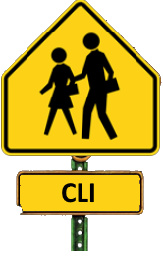

Router Profile Mapping to OpenC2
Actions on objects tightly controlled
Unstructured, non-standard, changes by release, designed for human scale
Comparing any two routers is non-trivial (e.g., 500+ page cheat sheet )
Actions and objects decoupled
Structured, early standards, changes by release, designed for machines
Comparing any two routers is easier, but the volume of information is huge (e.g., hundreds of models with up to hundreds of objects per software release )
For a generic router profile, a context-independent language binding of OpenC2 won’t be generalized.
Too many underlying technologies (e.g., VLAN, VRF, MPLS, EVPN, LISP, 802.11ah, VXLAN)
Volume and churn of what is actually behind the router abstraction has spawned industries
But we can provide a reference-mapping
CLI: particular router, using a particular release, for selected network technologies
YANG: subset of models, for selected network technologies
This is why we have abstractions
(i.e., OpenC2)

